Slide 1
LOAD FLOW ANALYSIS & SHUNT COMPENSATION

Slide 2
LOAD FLOW ANALYSIS
Load flow analysis, also known as power flow analysis, is a computational method used to study the steady-state behavior of an electrical power system. It is used to determine the voltage and phase angle at each bus in the network, as well as the power flow on each transmission line and generator.
In our project, we are using Gauss-Seidel method for load flow analysis.
After performing load flow analysis, we improve the voltage profile by shunt compensation.

Slide 3
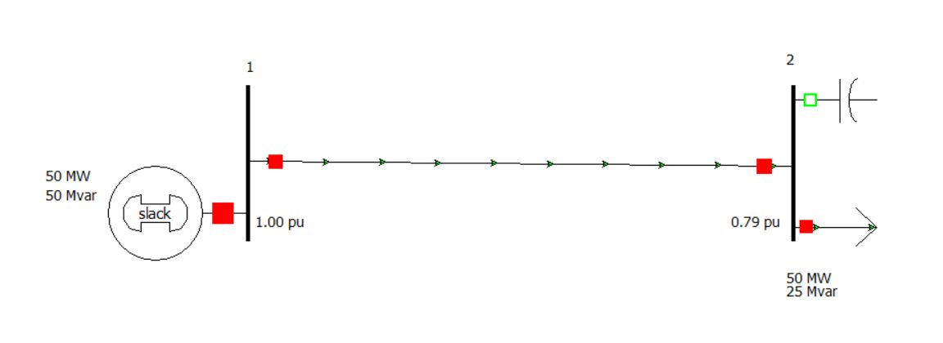
ANALYSIS PEFORMED FOR 2 BUS SYSTEM

Slide 4
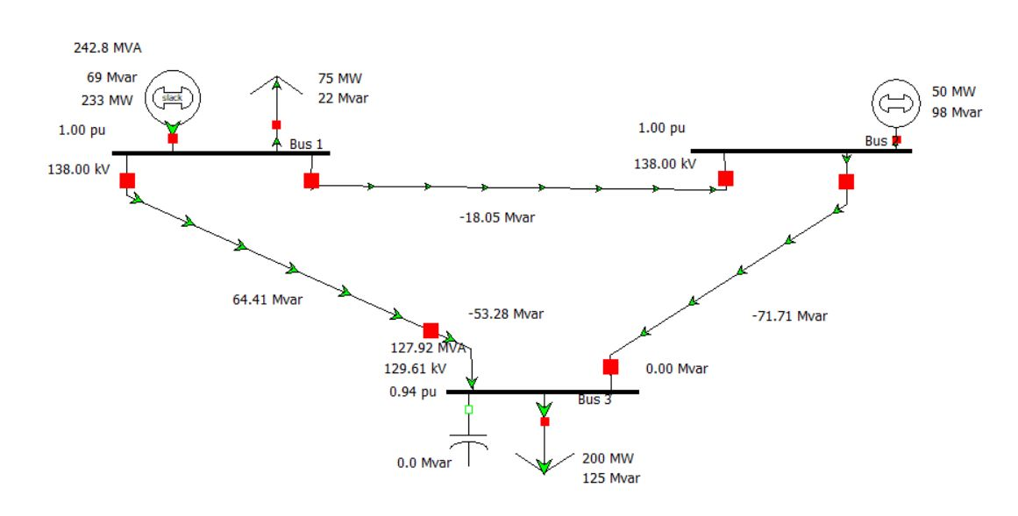
ANALYSIS PEFORMED FOR 3 BUS SYSTEM

Slide 5
COMPENSATION
The voltage profile obtained is lower than the required one. So, the appliances will not work properly.
Therefore, we need to add compensation. There are two types of compensation – Internal and External.
We use external capacitive shunt compensation to improve the voltage profile.

Slide 6
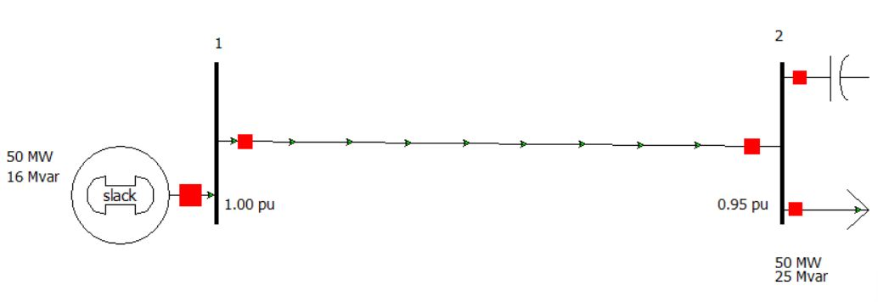
ANALYSIS WITH ADDED COMPENSATION
Here, the voltage at bus 2 has improved from 0.79 pu to 0.95 pu.

Slide 7
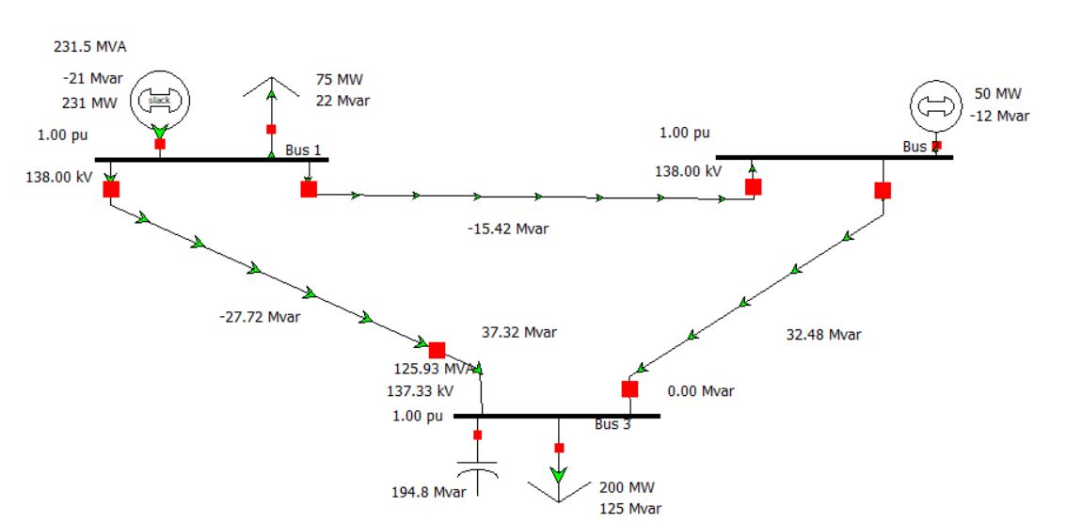
Here, the voltage at bus 3 has improved from 0.94 pu to 1 pu.

Slide 8
Not yet Done ……..
Power world simulator is a heavy software in terms of computation and complex UI (Difficult for beginners). So,we created a much simple and easy to use Mobile App – PowerFlow.
PowerFlow is an Android Mobile Application which can perform the Loadflow analysis and Shunt Compensation with absolutely ZERO Lag and no crashes

Slide 9
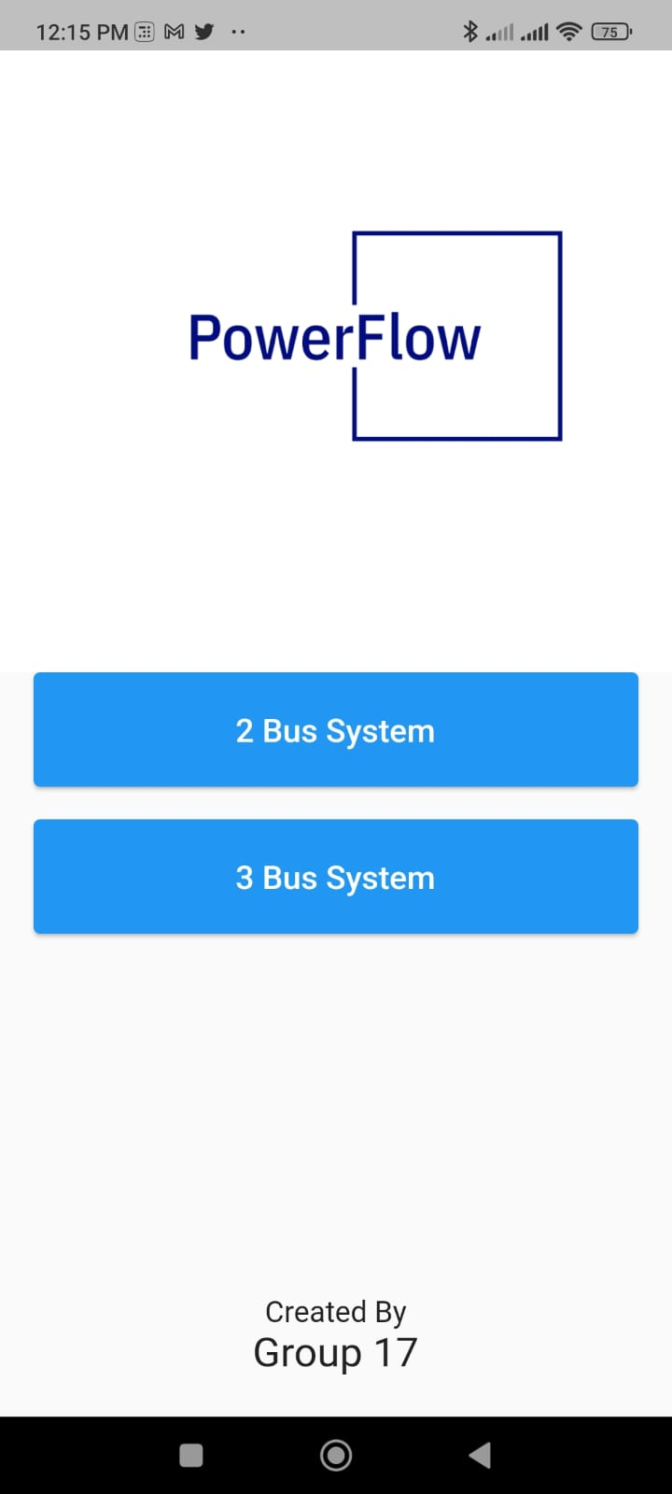
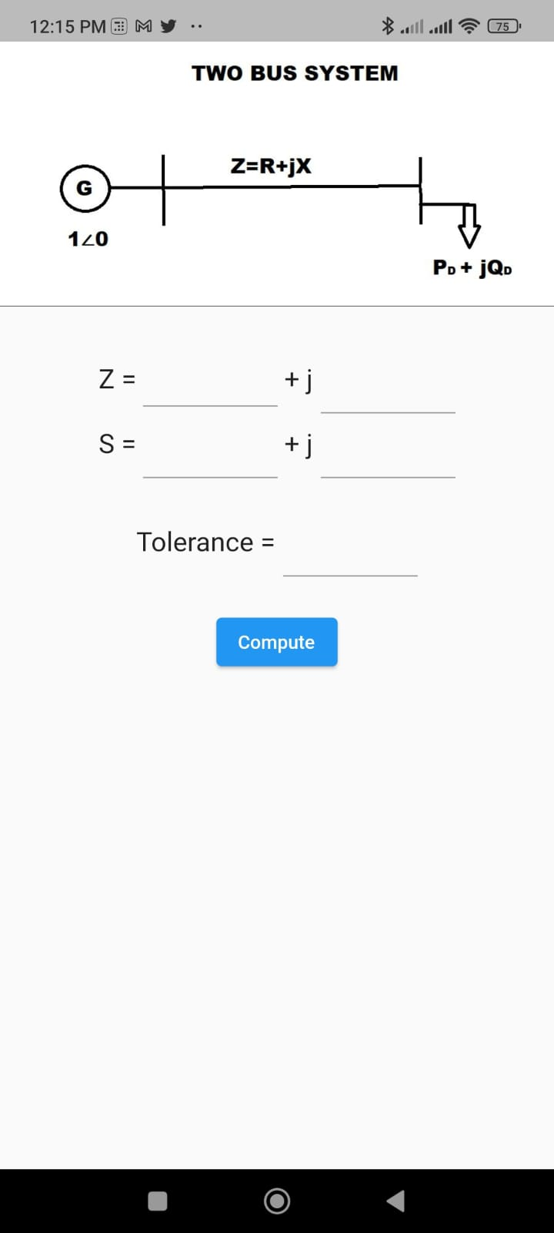
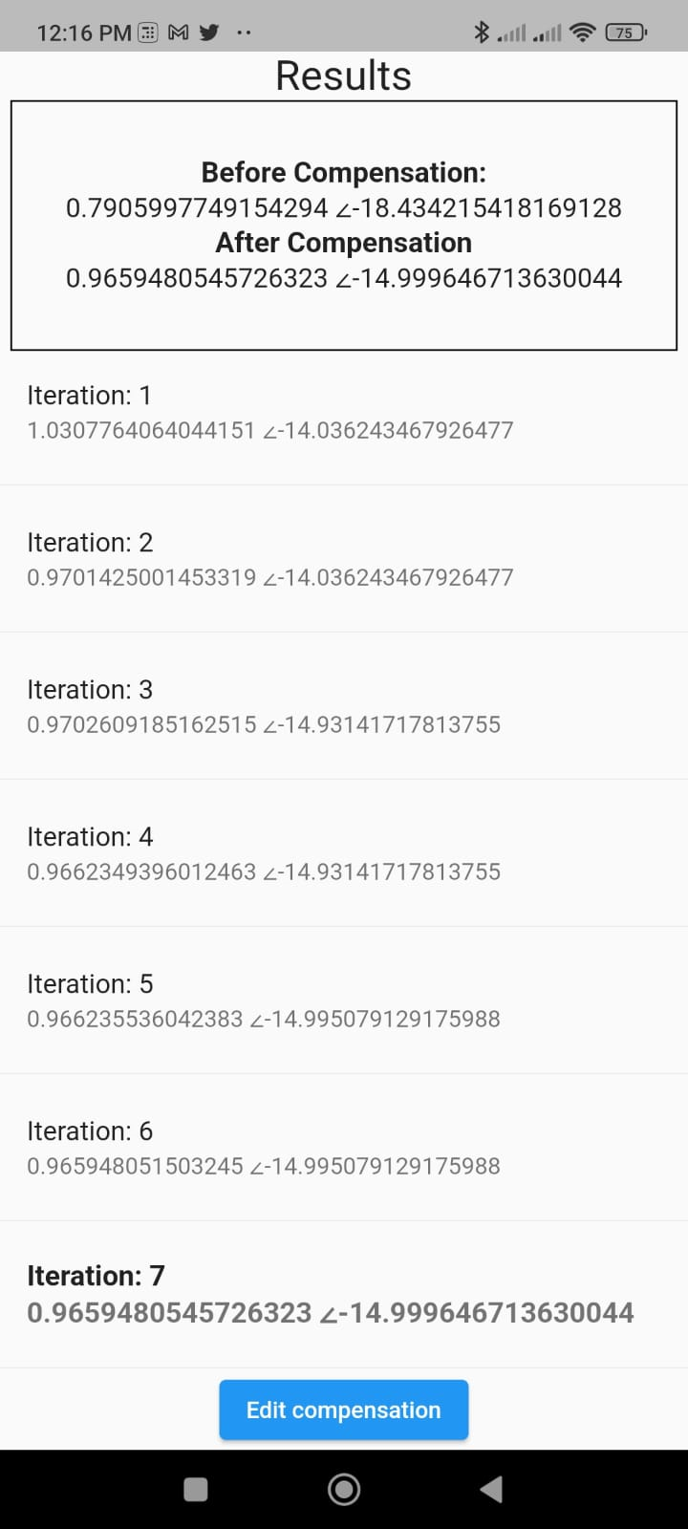
POWERFLOW App

Slide 10
Thank you…
Group 17

